Slide 1


6 Reasons Micro-Learning
Will Make a
Huge Impact
In Your Organization
Notes:
http://prositions.com
http://prositions.com/about-us/

Slide 2



Ellen
Frank
Notes:
http://prositions.com/about-us/executive-team/

Slide 3

Newest Trends in Learning
Chunked
Social
Mobile
Virtual
Gamified
Adaptive
Experiential
Blended
Convenient
Notes:
http://joshbersin.com/2017/03/the-disruption-of-digital-learning-ten-things-we-have-learned/
The training and development industry has been making many transitions, but this is one of the most significant.
Micro-Learning is a leading edge change in the marketplace.
It’s no longer two hour courses, rather short modules, courses, videos, etc.
Influence of social media and platforms changes the way communication occurs
A huge theme for micro-learning is mobile technology
We can now put extremely sophisticated content in our pocket – it’s a profound change
One of the most important things to note is convenience. Consumers today want convenience. They want to do things on their own time, their own schedule.

Slide 4

Micro-Learning
Micro-learning is a method of learning that delivers content to employees in short, very specific bursts (think “bite-sized learning” or “learning nuggets”).
Micro-learning activities are usually completed in less than four minutes (1-7 minutes), making them digestible and manageable.
Notes:
http://www.aberdeen.com/research/12069/rr-best-practice-microlearning/content.aspx
The length of micro-learning can change depending on the topic and instruction covered.

Slide 5

6 Reasons Micro-Learning is Hot Today!
Demand from Modern Learners
Learner Fatigue & Frustration
Busy Work Environments
Budget & Resource Constraints
Need to Reach More Learners
Leverage Technology Advancements

Slide 6

1. Demand From the Modern Learner
Notes:
Modern and Mobile Learner – Not by age or generation! All ages are exhibiting these traits.

Slide 7

PROFILE OF A
MODERN LEARNER
Crave Instant Access to Information
Seek Social Validation
Search Online for Help at Work
Have Shorter Attention Spans
Comfortable with Technology
Notes:
Crave Instant Access to Information- Modern learners are well educated, highly informed, and have constant access to information to make decisions.
Seek Social Validation- they crave collaboration and trust peers as a source of truth more than senior authority figures. Coaching and mentoring is welcome, but changing and becoming democratized.
Have Shorter Attention Spans- Typically they won’t watch a training video longer than 10 minutes and won’t sit through a 2-hour eLearning course.
Search Online for Help at Work- Over 75% of modern learners search online for help with their jobs. On average they spend 2 hours a day searching for “job-related” information.
Comfortable with Technology- They are online 27 times a day, unlock their smartphones 9 times each hour, and expect technology to support their learning.
https://www.bersin.com/Practice/Detail.aspx?id=18071
https://mrmck.wordpress.com/2015/06/19/meet-the-modern-learner-infographic/

Slide 8

The average
attention span of a goldfish is
9 seconds.
The average attention span of
an adult in the
year 2000 was
12 seconds
Today it is down to about 8 seconds
Notes:
http://time.com/3858309/attention-spans-goldfish/

Slide 9

Modern Learners Are Mobile
WHAT!?
American workers check their mobile phones approximately 8 billion times a day
The average worker is 150 times per day
In other words, that is where employees spend their time
Notes:
We’re becoming dependent on this mobile device.
http://joshbersin.com/2017/03/the-disruption-of-digital-learning-ten-things-we-have-learned/
http://time.com/4147614/smartphone-usage-us-2015/

Slide 10

For Generation Z…
the only phone they’ve ever known is a smart phone
Notes:
Born 1994/5 until the present.
New employees entering the organization have a high level of expectation of what that device can and will do for them.

Slide 11


Left to Their Own Devices!
Over 70% of employees now use their personal mobile devices to access job related information and training.
Notes:
As training professionals, we used to roll out a major technological advance we would have to make an investment in infrastructure or in hardware.
Today most modern learners are going to have access to a smart phone, AND most of them feel it’s normal to get job-related information on their own personal devices.
http://info.shiftelearning.com/blog/bid/331987/mobile-learning-stats-that-will-make-you-rethink-your-training-strategy

Slide 12



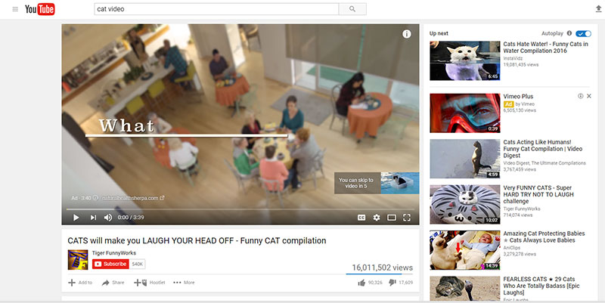

The power of micro-video
4:20:00
Notes:
According to Nielson Survey, video is the most popular way to consume content globally
http://www.nielsen.com/us/en/press-room/2016/keep-calm-and-watch-video-a-global-study-of-traditional-tv-and-streaming.html
YouTube has over 1.3 billion users https://fortunelords.com/youtube-statistics/
YouTube over 1 billion views per day from mobile devices
The average YouTube video is 4 minutes 20 seconds. But only 60% of viewers complete these, while 75% will complete a 1 to 2 minute video.

Slide 13

Why Not Just Use YouTube?
Search and “distracted viewing” wastes significant time and productivity
On average 1.8 hours
per day
No consistency
Match with organizational culture, competencies, and goals
Notes:
YouTube is the number one training site in the world. BUT:
The biggest problem of just using YouTube is wandering. People will find their information, but it’s easy to get distracted and then share it with coworkers. It’s a huge drain on productivity.
“According to a McKinsey report, employees spend 1.8 hours every day—9.3 hours per week, on average—searching and gathering information.” Nov 8, 2013
Search and “distracted viewing” wastes significant time and productivity (see calculator)
Not curated – “Box of Chocolates?”
You never know what you’re going to get, is it correct?
There is no consistency
It may not match with organizational culture and goals
Using micro-learning in an easily searchable manner can significantly cut down on the wasted time going to YouTube for these answers.

Slide 14
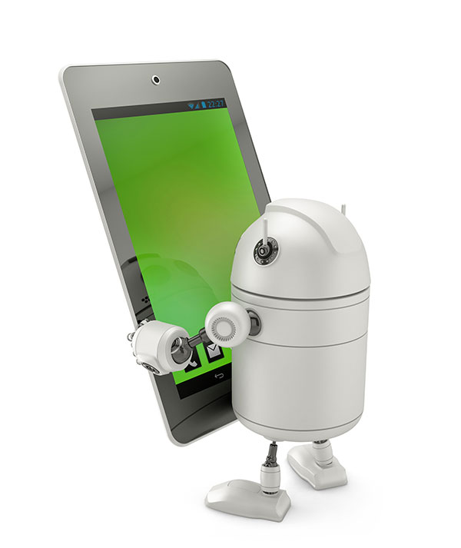
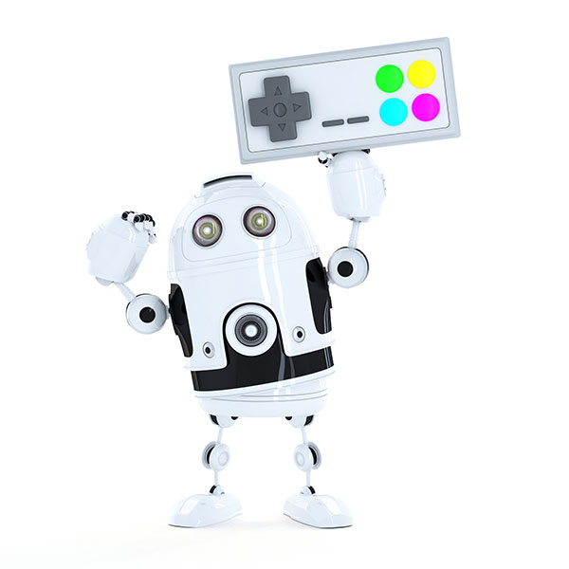


Expectations Have Changed
YouTube, Google, Wikipedia
Smartphones, Apps, GPS
Gaming, Badges, VR
Podcasting
AI, Machine Learning
Cloud Hosting
Internet of Everything
Notes:
Technology Shift has raised the bar!!
20.4 Billions of device connected to the Net 2017
31 Billion by 2025
https://www.statista.com/statistics/471264/iot-number-of-connected-devices-worldwide/

Slide 15

Tech savvy impressions impact recruitment
and retention!
Notes:
Perception of old outdated tech negatively impacts recruitment and retention!

Slide 16

2. Learner Fatigue and Frustration
Notes:
E-learning course utilization statistics are dropping
“Who wants to spend 1-2 hours on a boring e-learning course?”
Legacy LMS systems not designed for mobile-learning and retrofits are frustrating

Slide 17

E-learning course access and completion rates are
going down!
Notes:
Traditional eLearning courses of 1-2 hour seat times are dropping in usage. Simply because people are getting fatigued.
http://troydean.com.au/2016/05/online-course-completion-rates/
https://elearningindustry.com/increase-completion-rates-online-course-5-ways

Slide 18

OMG… not another
2-hour course!
Notes:
Courses with upfront assessments can be a huge barrier to the learning that needs to take place.
It perpetuates user frustration.
The modern learner wants access quickly and conveniently.

Slide 19

Micro-learning delivers short, focused sessions that help learners avoid mental burnout and can promote increased energy and alertness.
Notes:
Fights Learner Fatigue- Delivers short, focused sessions that help learners avoid mental burnout and promote energy and alertness.

Slide 20

Legacy LMS may not truly support mobile or micro!
Notes:
One issue that can cause fatigue is if the system is cumbersome and a user has to take multiple steps to get into their training and learning, it can crate a barrier.
Micro-learning doesn’t have to replace your LMS, but it can be incorporated into it.

Slide 21

3. Busy Work Environment

Slide 22

  Employees are interrupted every 4 minutes on average
  Employees only have about 5 minutes a day to allot for training
  58% of employees say they’d use their organization’s learning software more if the content was broken up into shorter lessons
Notes:
Employees are interrupted every 4 minutes on average
They have about 5 minutes to allot to training per day
https://mrmck.wordpress.com/2015/06/19/meet-the-modern-learner-infographic/
Bersin by Deloitte Meet the Modern Learner
58% of employees say they’d use their organization’s learning software more if the content was broken up into shorter lessons
https://twitter.com/Grovo

Slide 23

Learner Benefits:
More Convenient
More Adaptive
Expands Short-term Memory
Eases Integration into Long-term Memory
Increases Retention Rates by 50% to 65%
Notes:
More Convenient- Allows learners to access anytime, anywhere.
More Adaptive- Caters to a variety of learning styles, including visual, auditory, and kinesthetic and tactile.
Expands Short-term Memory- Eases integration into long-term memory. Retention rates can increase by 50% to 65%
Faster Speed to Competence- Can increase by 40% to 50%
http://a1.grovo.com/asset/whitepapers/Grovo-BiteSize-Microlearning-whitepaper.pdf

Slide 24

Faster Speed to Competence
Can increase by 40% to 50%
LEARNER BENEFITS
Notes:
Micro-learning can help employees get up to speed more quickly.
While it’s not always appropriate for certain topics, but it should be present in blended learning.
http://a1.grovo.com/asset/whitepapers/Grovo-BiteSize-Microlearning-whitepaper.pdf

Slide 25

4. Budget & Resource Constraints

Slide 26

Organizational Benefits
More Affordable - Cuts Development Costs 50%-75%
More Agile - Increases Speed to Launch 300%
Increases Completion Rates - Up to 75%-95%
Easier to Manage/Update
Decreases Administrative Burden
Wider Utility
Supports Globalization and Localization
Notes:
More Affordable Cuts development costs by 50% to 75%
More Agile Increases the speed of development and launch by 300%
Increases Completions Rates increase from 80%-95%
Easier to Manage/Update Modular assembly is easier to manage in a CMS, so changes are fast and simple
Decreases Administrative Burdens Through the use of mobile apps and simplified administration tools
Wider Utility Can be integrated in with existing LMS and PMS sfotware
Supports Globalization and Localization- Ideal for global training as small segments are easier to translate and localize
http://a1.grovo.com/asset/whitepapers/Grovo-BiteSize-Microlearning-whitepaper.pdf

Slide 27

5. Need to Reach More Learners

Slide 28

82% of Workers Don’t Have Desks!
Notes:
Forbes, Community Voice April 11, 2017 “No Email, No Problem”
https://www.forbes.com/sites/forbeshumanresourcescouncil/2017/04/11/no-email-no-problem-creating-a-feedback-loop-with-non-desk-workers/#502d50875705

Slide 29

No Desk,
No Problem!
Field Repair/Service
Medical Professionals
Plant/Manufacturing
Distribution/Warehouse
Construction/HVAC
Field Engineers
Retail
Field Sales
Energy Workers
Agriculture
Home/Remote Workers
Transportation/Trucking
Local Delivery
Government
Teacher
Notes:
Traditional LMS aren’t always the best solution for those without a desktop or laptop.
How do you reach those people?
Through micro and mobile learning, you can reach FAR more people.
AND that’s how they want to consume it!

Slide 30

Audio Versions
DOWNLOAD
Notes:
Growing popularity of Podcasts!
Great for those who are traveling, don’t have internet all the time, or prefer auditory learning.

Slide 31

6. Leverage Technology Advances

Slide 32






HDTV Quality
and Beyond
Notes:
Deliver HD video quality Netflix, Amazon, Apple TV, ESPN, Youtube, Vimeo, Hulu
Smart Phones now have better video quality than when I shot in a studio with 1” (also better than SCORM courses)
Because our learners are USED to this type of quality and access, we need to meet their expectations with our training.

Slide 33

Buyer beware!
Pinch to zoom is a retrofit!
Mobile “Friendly”
Mobile “Ready”
Mobile “Responsive”
Mobile “Adaptive”
Notes:
Buyers beware!!! Mobile First over Mobile Responsive, Friendly, Ready
Pinch to Zoom is not Mobile First!
This is important to know and be able to tell the difference in what purchasing not only micro-learning but training in general.

Slide 34
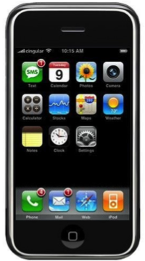

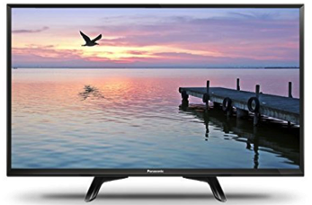


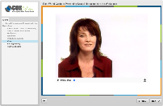
Mobile Design Differences
Mobile First
The user experience was designed for mobile phones before any other version, so it displays perfectly with no extra adjustments and video quality looks the best.
Responsive
You may have to ‘pinch and zoom’ to view the content on a mobile device. Video quality can be less. This is usually a retrofit to make older content and apps mobile friendly.
Adaptive
You need to manually select your screen size in order for the content to display correctly. Think of the TV in your family room.
Notes:
Mobile first web design
means designing an online experience for mobile before designing it for the desktop Web—or any other device. In the past, when users' focus was on the desktop Web, mobile design was an afterthought. (HD video quality)
Responsive web design (RWD) is an approach to web design aimed at allowing desktop webpages to be viewed in response to the size of the screen or web browser one is viewing with. Automatically sensed by the application. (Pinch to zoom)
Adaptive web design (AWD) is an approach to web design aimed at allowing desktop webpages to be viewed based on to the size of the screen or web browser one is viewing with. But the user must select a screen size.

Slide 35

Putting It
All Together

Slide 36

Another tool for our belt
Notes:
Micro-learning is not a thing that is going to take over your LMS. This is another tool to use alongside existing programs and technology.

Slide 37
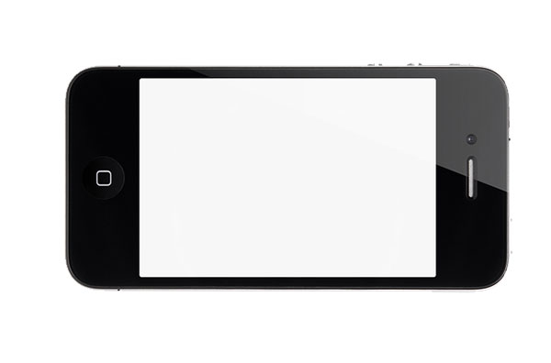



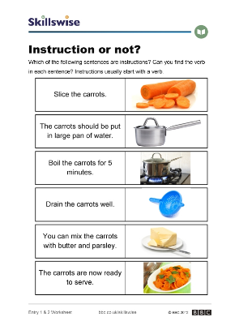
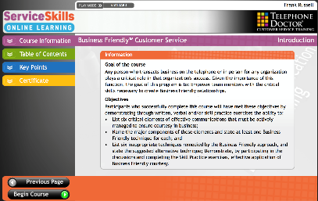
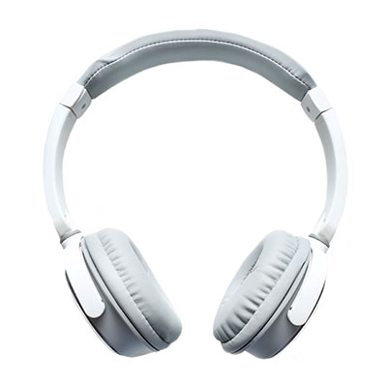
Micro-Learning Formats
SCORM
Video
AUDIO
TEXT
Notes:
Format is important. Micro-learning is generally video, but other formats may be more appropriate.
Be sure to script accordingly.
Audio shouldn’t have references to a visual.
Text doesn’t have to be boring – add pictures!
SCORM courses can be micro, too.

Slide 38

Best Micro-Learning
Small but complete
learning experience
Bite-sized chunks
Step-by-step structure
Convenient access
Intuitive search and use
Platform independent
Engaging and useful

Slide 39
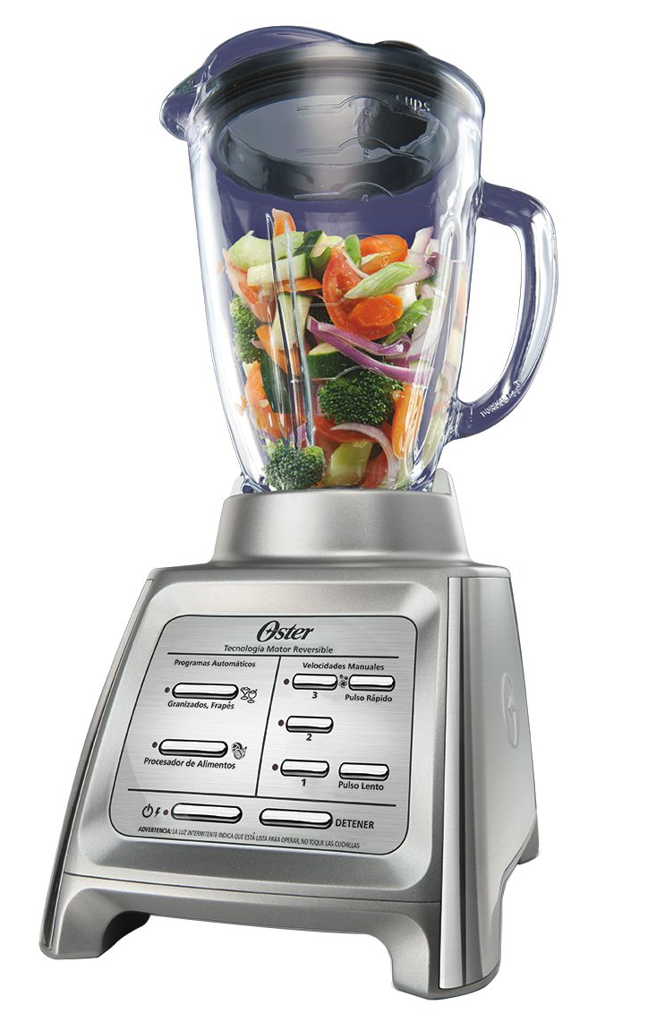
Part of a Blended Program
Development
Program
Classroom
Self-paced
Performance Support
Virtual
Notes:
http://prositions.com/training-content/

Slide 40



Ways to Use Micro-learning
Pre and/or
Post Training
Serial or
Linked Modules
Performance Support
1.
2.
3.
4.
5.
6.
7.
8.
9.
Assignments
Notes:
For performance support, push it out to your learners!
Send out a weekly email or use it with experiential learning.

Slide 41

Pop Quiz Question
What is the difference between training and performance support?

Slide 42
Answer
Training
Performance Support
Want to LEARN something
Takes 1-hour to several days
Need to show mastery
Better for certification
SCORM, LMS
Want to DO something ASAP
Short 1-7 minutes
Need a quick result
Don’t care about certification
Streaming video, offline audio
Can support training

Slide 43

WHEN TO USE TRAINING
Safety/Security Certification
Long-Term Development
Complex Set of Skills

Slide 44





WHEN TO USE PERFORMANCE SUPPORT
Safety Situation
Product Information
Performance Conversation

Slide 45
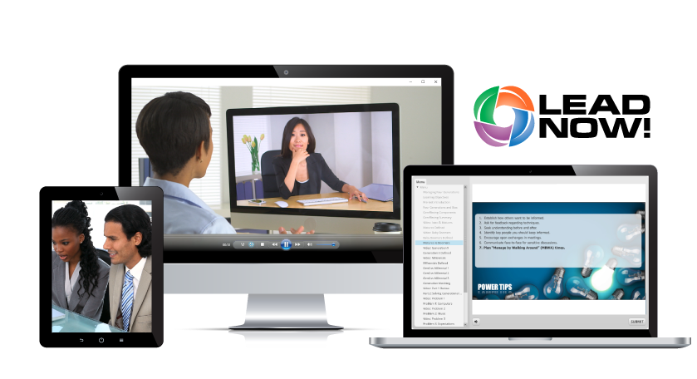
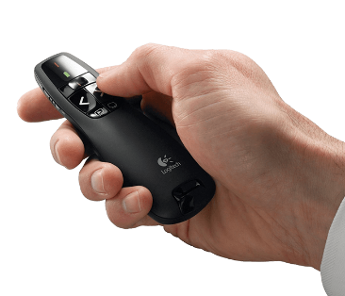
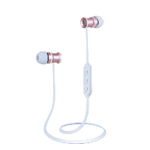
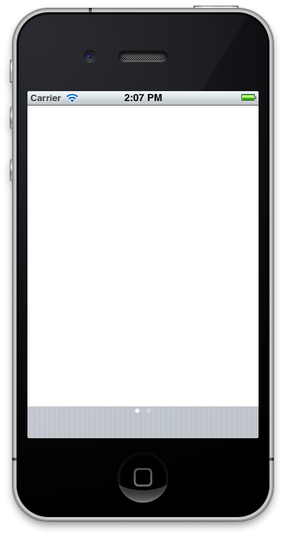

VERY FLEXIBLE DELIVERY OPTIONS

Slide 46
Technology
Consider These Before Buying
Mobile FIRST design
Intuitive interface & features
Short, HD video & audio
Comprehensive libraries
Free & regular content updates
Host your own content
Strong administration & reporting
Intuitive search & recommendations
Integration with LMS/HRIS

Slide 47
Partners
Question Your Potential Partners
Strong customer SUPPORT
Technical expertise
Background in L&D
Proven technology leader
Thought leader in micro-learning
Advocate for performance support
High-quality content & production
Specific project management team
Simple and flexible payment options
Friendly people who CARE

Slide 48

?
Questions?

